Slide 1
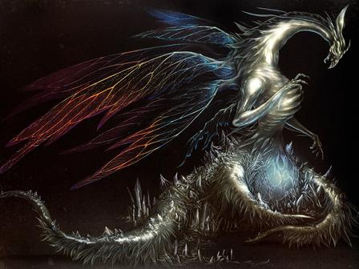

Team “Seath the scaleless”
Object-oriented programming project
By:
Христо Петров
Ивайло Глухчев
Росен Илиев
Звезделин Димитров
Живко Ангелов
Илия Боянов

Slide 2
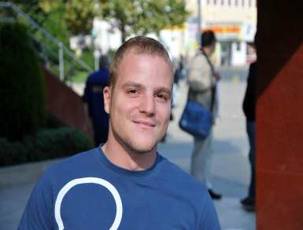


Team members
Христо Петров
Game design
Game engine integration
Ивайло Глухчев
Code architecture
Player behavior
Росен Илиев
Game design
Code architecture

Slide 3
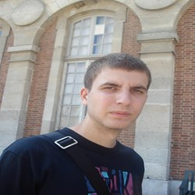
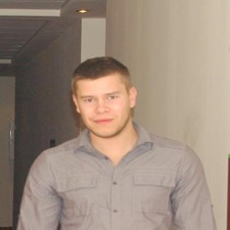

Team members
Звезделин Димитров
Code architecture
Code optimization
Живко Ангелов
Coding
Илия Боянов
Coding

Slide 4
Project task
Create a game on C#/Java following the OOP principles.
Team “Seath the Scaleless” project name:
“Pocket Monsters - Minified”
GitHub repository: https://github.com/Team-Seath-The-Scaleless/Pocket-Monsters-Minified

Slide 5

Game preview

Slide 6
result
Short but entertaining experience
Pixelated fun
Something that can be easily build for mobile devices
Nostalgia

Slide 7
Tools and resources
Languages: C#
IDEs: Visual Studio, Unity 3D
Libraries: NGUI
Version control tool: GitHub
Web: Google

Slide 8
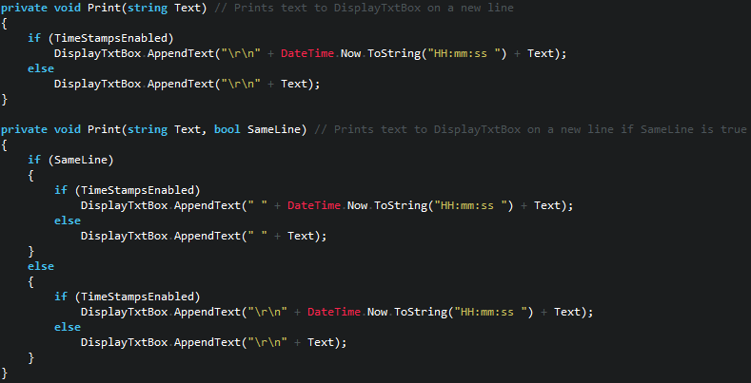
Source preview

Slide 9
Thank you for your attention

